Slide 1
ASSIGNMENT 1
Qualification | BTEC Level 5 HND Diploma in Computing
Unit number and title | Unit 14: Business Intelligence
Submission date | 30/12/2021 | Date Received 1st submission | 30/12/2021
Re-submission Date |  | Date Received 2nd submission
Student Name | Le Quoc Thai | Student ID | GCH190134
Class | GCH0803 | Assessor name | Doan Trung Tung
Student declaration I certify that the assignment submission is entirely my own work and I fully understand the consequences of plagiarism. I understand that making a false declaration is a form of malpractice.
 |  | Student’s signature | Thai

Slide 2
Grading grid
P1 | P2 | M1 | M2 | D1 | D2
❒ Summative Feedback: ❒ Resubmission Feedback:
Grade: | Assessor Signature: | Date:
IV Signature:

Slide 3
E-commerce Fashion
Nguyen Dang Khoa
Ngo Tuan Anh
Luong Ngoc Thai
Nguyen Vu Thai
Le Quoc Thai

Slide 4
Introduction
01
Software
02
TABLE OF CONTENTS
3 types of decision making levels
03

Slide 5
01
Introduction
Our company is a fashion company specializing in selling fashion products all year round, has an e-commerce website to easily reach customers in the current 4.0 era. We have all services such as customer delivery, warehousing, returns.

Slide 6
The process of selling fashion e-commerce
Our sales process starts with the customer, the customer will be able to search for the product they want on the company's website, then select the cart and then pay.
There will be two cases after payment:
If out of stock, the system will stop the customer’s order and contact the customer.
If there is stock, the system will notify the customer that the order is successful, then we will place the order and send the item to the carrier. The final step will be to deliver the item to the customer.

Slide 7
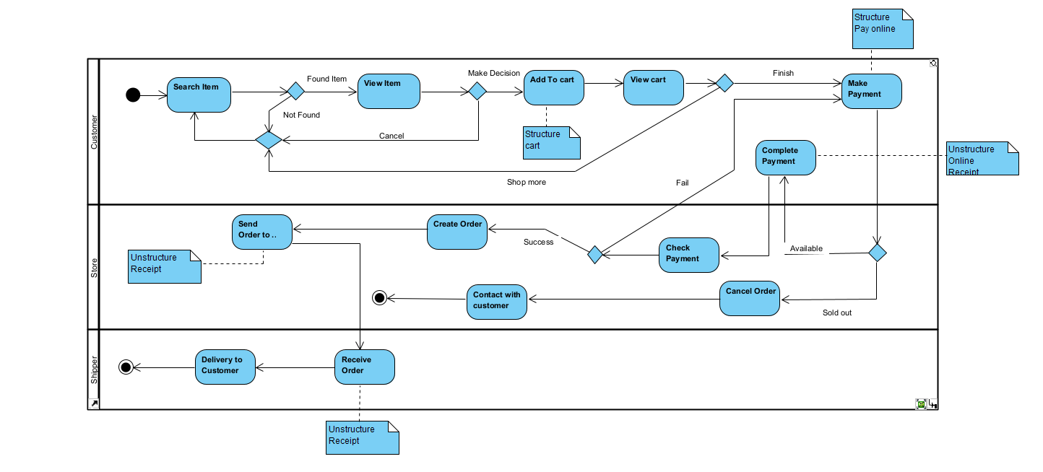
The process of selling fashion e-commerce (diagram)

Slide 8
Fashion import process
Our company's import process begins with the fact that we will send a request for the items we need to import to the supplier. If the request is not approved, they will send a notification again. The request is approved, the supplier will issue an invoice for our company to pay to communicate with the carrier. After our company receives the items, we will check the items carefully, if it is as requested before, we will display the items for sale to the customer, and if the items are defective or missing, we will notify the supplier.

Slide 9
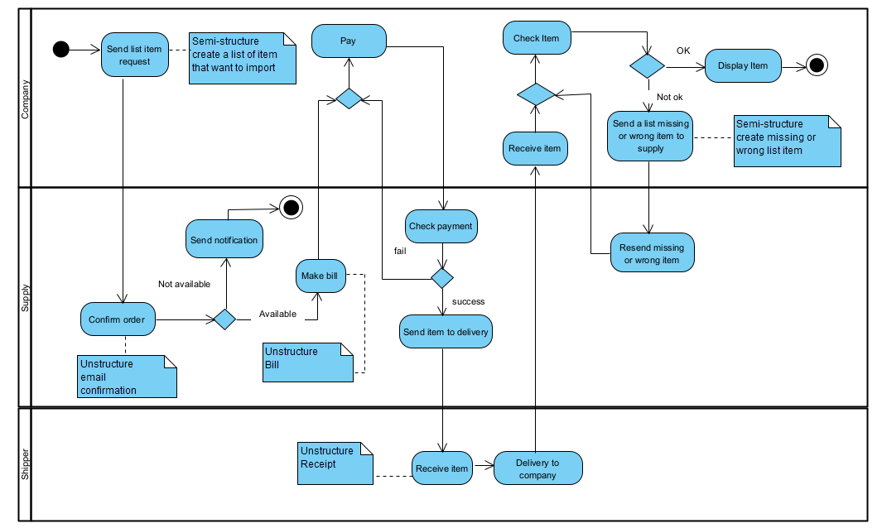
Fashion import process (diagram)

Slide 10
Return process
Our return process starts with the customer, the customer will send a request to our company, if our company does not accept the request, we will send a notice to the customer.
If we accept the request, we will send a notice to the customer to transfer to the carrier, then the carrier will deliver to the company, the company's task is to check the item if there is any problem. If it is not the same as the items sent by the company or damaged from the customer's side, we will not accept and return the items to the customer. If the item is in original condition, not damaged, we will refund.

Slide 11
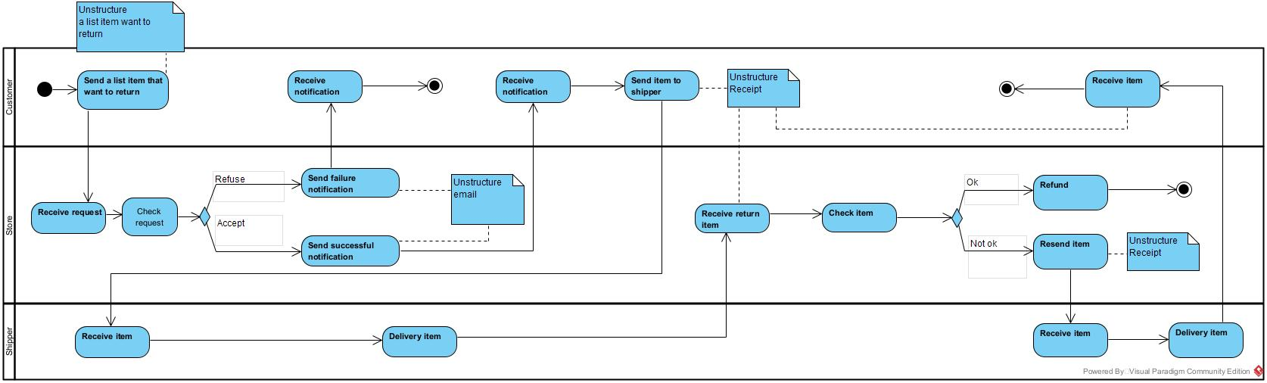
Return process(diagram)

Slide 12
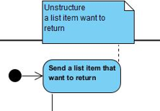
Unstructured data
Unstructured data is data that isn't arranged in a preset way or doesn't have an established data model, making it unsuitable for a traditional relational database. So there are other platforms for storing and managing unstructured data; it is becoming more common in IT systems and is utilized by businesses in a number of business intelligence and analytics applications.
For example, customer wants to submit a return request, must take a picture, and write a request from the customer

Slide 13

Semi-structured data
Semi-structured data is data that is not stored in a relational database but has organizational qualities that make it easier to examine. Some processes can be stored in a relation database (though this may be difficult for semi-structured data), but semi-structured data exists to save space.
For example: The company wants to send a list of missing or defective items, we already have a list, we just need to choose the product and write a request.

Slide 14
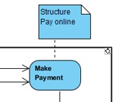
Structured data
Structured data has components that can be addressed for effective analysis. It has been structured into a database, which is a formatted repository. It refers to any data that may be put in a table with rows and columns in a SQL database. They have relational keys and can be mapped into pre-designed fields with ease.
For example: The company wants to pay the bill, the company just needs to go to the available banking application and transfer the money, everything is pre-programmed and the money will go to the supplier's account.

Slide 15
02
Software

Slide 16



Pros
Cons
EBIZ:
Ebiz management software can collect money through manually entering products into the machine or scanning barcodes very conveniently.
Moreover in this software there are sales report charts very convenient for BI.
This application can also be accessed anytime, anywhere as long as there is an internet connection.
This software also integrates online delivery of VN Post and GHTK.
GHTK:
GHTK has very cheap shipping cost.
Staff is quite friendly.
VnPost:
VnPost has 3 types of shipping: normal, fast, express. Users can freely choose.
Delivery speed is quite fast, usually on or ahead of time.
EBIZ:
Does not support wholesale, only suitable for retail.
There is no clear decentralization, anyone can manage and use full functions with the product.
It costs a lot to rent every month.
Because it is used over a network connection, it is completely possible to be attacked by hackers.
GHTK:
GHTK has very cheap shipping costs but the delivery speed is slow, sometimes there is a problem of delay.
Careless item forwarding, easy item damage.
VnPost:
VnPost has a rather expensive shipping fee.
The attitude of the delivery staff is poor, often have to go to the post office to receive.

Slide 17
03
3 types of decision 03 making levels
Operational - Tactical - Strategic

Slide 18
Operational
Operational The operational strategy outlines the company's day-to-day operations. The operational plan lays forth a road map for achieving tactical goals in a reasonable amount of time. This strategy is very precise, with a focus on short-term goals. Policy, regulations, and procedure are examples of these.

Slide 19
BI of example (Operational)
The model of ABC company is very large, so the number of items and the amount of products sold is also very large. That makes controlling the amount of money sold and purchased very difficult for accountants when they have to manually count money and check money, which leads to a lot of time-consuming and misleading amounts, causing cause losses or errors to the company. Therefore, the management has planned to buy more Bill counters to achieve more efficiency. After applying BI, the director decided to buy Bill counter after learning that the amount of money to buy and sell is increasing. That gave us better control over the funds.

Slide 20
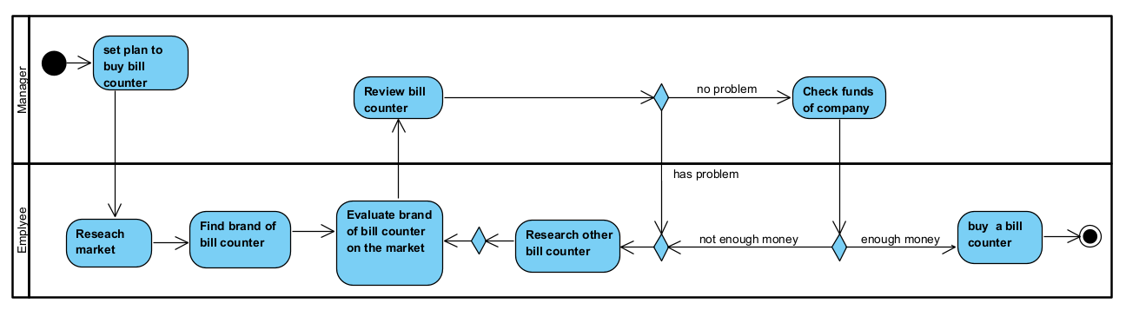
Example (Operational)

Slide 21
Tactical
Tactical: The tasks that are decided by the CEO, COO, CFO with medium influence in the mid-term, carried out for the purpose of achieving the small goals of the strategic plan.

Slide 22
BI of example (Tactical)
Our fashion house has applied BI since the end of 2020 and the parameters show that the demand for online shopping of customers is increasing. Especially during periods of social distancing due to COVID-19. Moreover, it is known that the rate of exchange and return due to ordering the wrong size also increased rapidly because customers have difficulty finding the correct size. So the manager decided to use the function of automatically selecting size according to parameters such as age, height, weight, etc. Moreover, customers can choose according to specific physique characteristics to conduct a search for clothing size. This has significantly reduced the phenomenon of returning products. Thereby helping the company increase sales revenue by helping them find the right clothing size as well as minimizing the cost of exchanging customers.

Slide 23
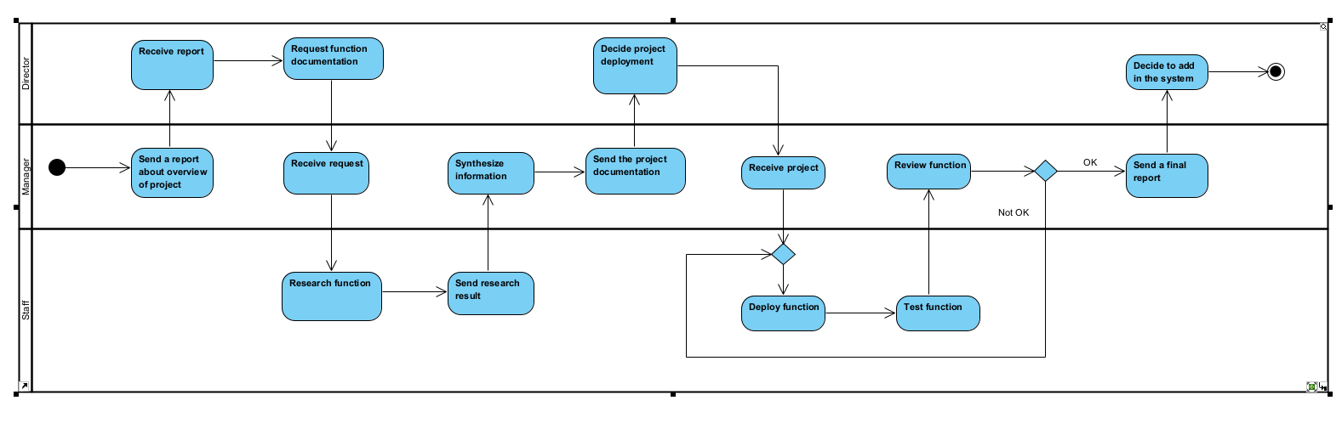
Example (Tactical)

Slide 24
Strategic
Strategy: The work given by management, shareholders have a great deal of influence that in the long term.

Slide 25
BI of example (Strategic)
Our company has applied real-time BI in all customer acquisition activities through the number of products this user has bought, processing customer orders and returns, and more accurate product information. The company also applies BI in analyzing data collected from surveying the clothing shopping market around the world. Our company has decided to open some new stores. After a while, the company recovered capital and increased revenue for the company. Expanding customer base worldwide.

Slide 26
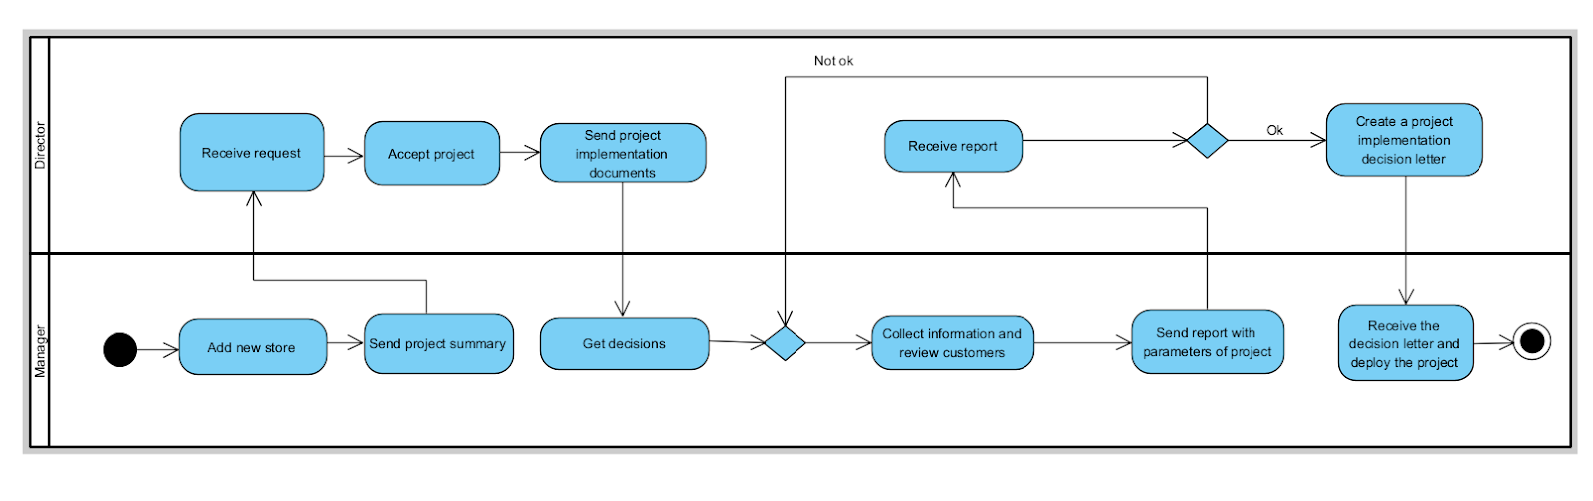
Example (Strategic)

Slide 27
Thanks for watching

